Slide 1
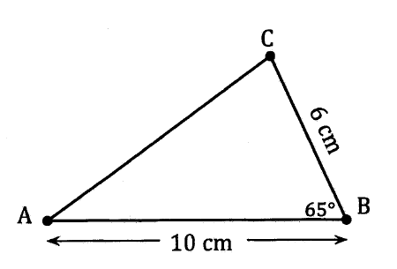
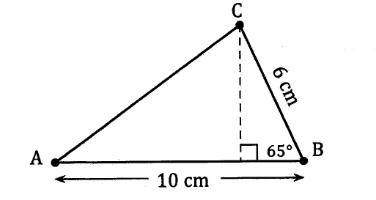
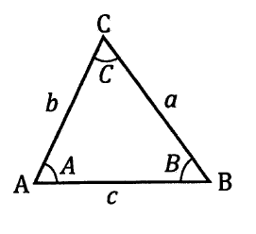
Non right angled triangles
Can we currently calculate the area of this triangle using 1/2bh?
No, we need to know the perpendicular height.
By drawing the perpendicular from C to AB we get two right angled triangles and we can use trigonometry to find the perpendicular height (and find the area).
By drawing a perpendicular from one vertex to the opposite side (creating right angled triangles) allows us to use trigonometry in a triangle that is not right angled.
We will use the usual way of naming sides and angles of a triangle.
Eg. In triangle ABC, the three angles are labelled A, B and C at each vertex and the sides opposite these angles are labelled a, b and c.

Slide 2
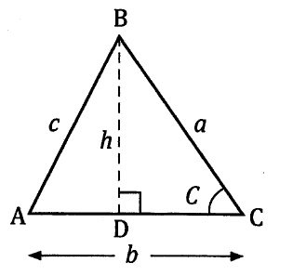
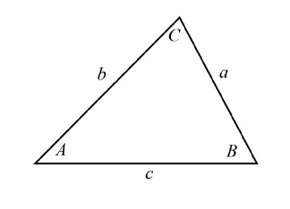
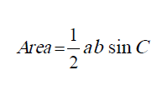
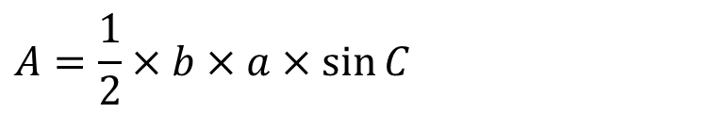
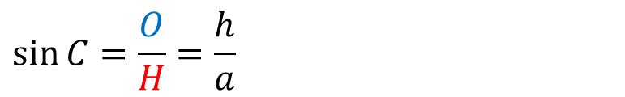
Area of a triangle using trigonometry
How do we find the perpendicular height (h) of the triangle?
$$\sin{C=\frac{O}{H}=\frac{h}{a}}$$
H
$$h=a×\sin{C}$$
O
A
$$A=\frac{1}{2}×b×a×\sin{C}$$
We can rearrange this to get:
The area of any triangle is half the product of two sides multiplied by the sine of the angle in between them.

Slide 3
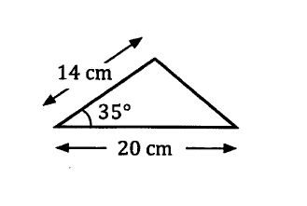

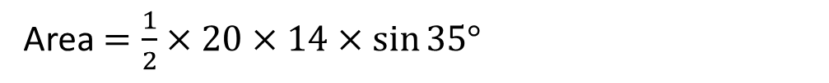
Examples
A
b
c
Area$=\frac{1}{2}×20×14×\sin{35°}$
C
B
a
Area$≈80.3 {cm}^{2}$

Slide 4
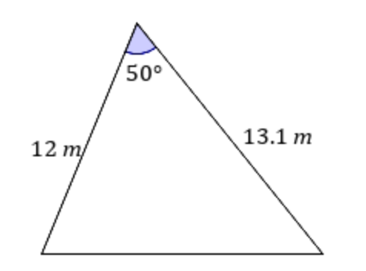

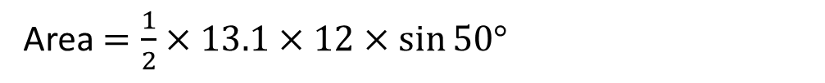
Examples
C
b
a
Area$=\frac{1}{2}×13.1×12×\sin{50°}$
A
B
c
Area$≈60.2 m^{2}$

Slide 5
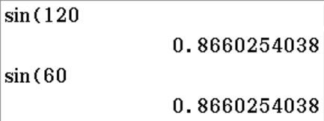
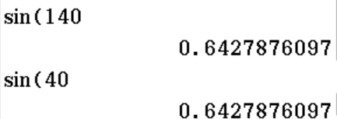
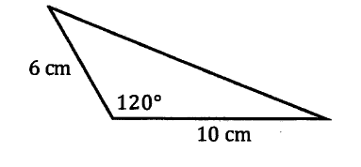
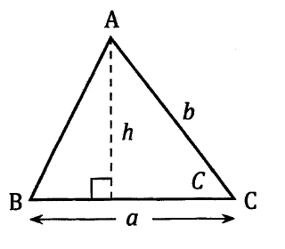
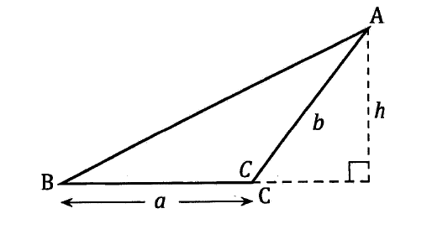
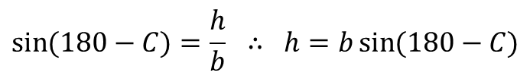
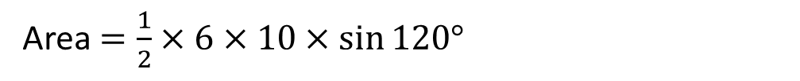
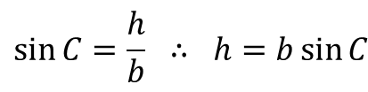

Area of a triangle using trigonometry
You might have noticed that the sine of some angles is the same as others.
We can also calculate the area of this triangle using the formula (despite there being an obtuse angle):
In fact we can say $\sin\left(180°−C\right)=\sin{C}$
We can use the area formula for all triangles, including when C is an obtuse angle.
Area$=\frac{1}{2}×6×10×\sin{120°}$
$$\sin{C=\frac{h}{b} ∴ h=b\sin{C}}$$
$$\sin{(180−C)=\frac{h}{b} ∴ h=b\sin{(180−C)}}$$
Area$≈26.0 cm^{2}$
$$A=\frac{1}{2}a×h = \frac{1}{2}ab\sin{C = \frac{1}{2}ab\sin{(180−C)}}$$

Slide 6
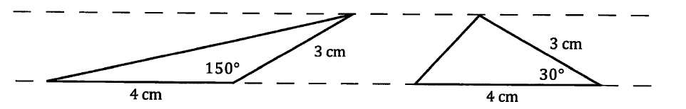




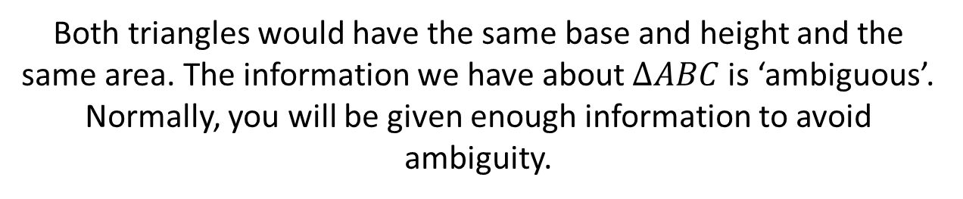
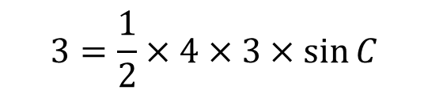
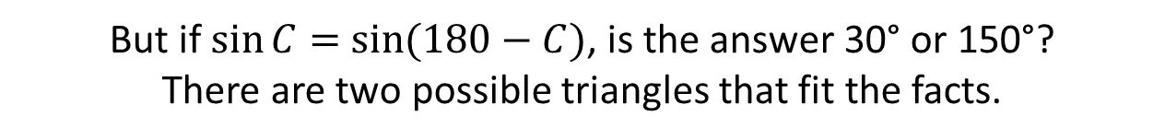
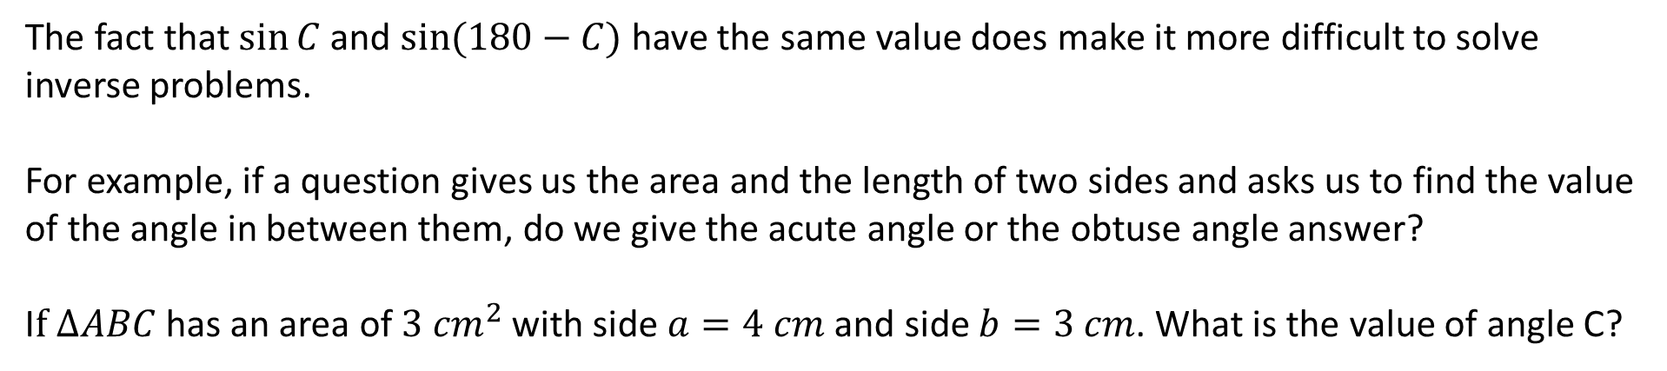
Area of a triangle using trigonometry
The fact that $\sin{C}$and $\sin{(180−C)}$have the same value does make it more difficult to solve inverse problems.
For example, if a question gives us the area and the length of two sides and asks us to find the value of the angle in between them, do we give the acute angle or the obtuse angle answer?
I$f ∆ABC$ has an area of $3 {cm}^{2}$with side $a=4 cm$ and side $b=3 cm$. What is the value of angle C?
But if $\sin{C}=$ $\sin{(180−C)}$, is the answer 30° or 150°?
There are two possible triangles that fit the facts.
$$3=\frac{1}{2}×4×3×\sin{C}$$
$$3=6×\sin{C}$$
$$\sin{C}=0.5$$
Both triangles would have the same base and height and the same area. The information we have about $∆ABC$is ‘ambiguous’.
Normally, you will be given enough information to avoid ambiguity.
$$C=\sin^{−1}(0.5)$$

Slide 7
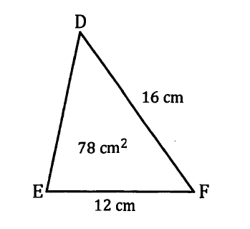


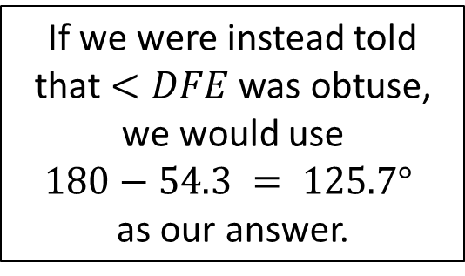



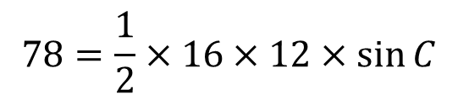
Examples
Triangle $DEF$ is such that $e=16 cm, d=12 cm,$ the area of the triangle is $78 {cm}^{2}$ and $<DFE$is an acute angle. Calculate the size of $<DFE$, correct to 1 decimal place.
If we were instead told that $<DFE$ was obtuse, we would use
$$180−54.3 = 125.7°$$
as our answer.
$$78=\frac{1}{2}×16×12×\sin{C}$$
$$78=96×\sin{C}$$
$$\sin{C}=0.8125$$
$$C=\sin^{−1}(0.8125)$$
$$<DFE=54.3°$$

Slide 8
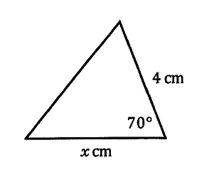

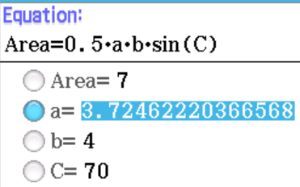
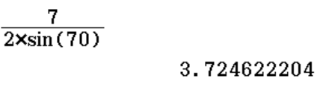



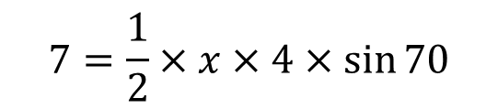
Examples
Given that the triangle has an area of $7 {cm}^{2}$, find $x$ correct to 1 decimal place.
$$7=\frac{1}{2}×x×4×\sin{70}$$
$$7=2×x×\sin{70}$$
$$x=\frac{7}{2×\sin{70}}$$
Can also use
Class Pad
E-activity
$$x=3.7 cm$$

Slide 9
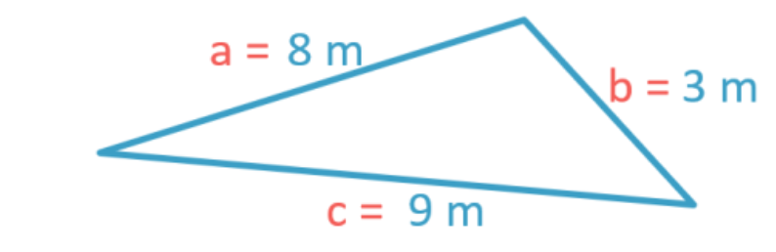

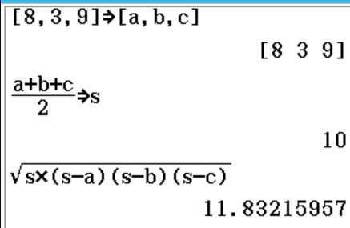
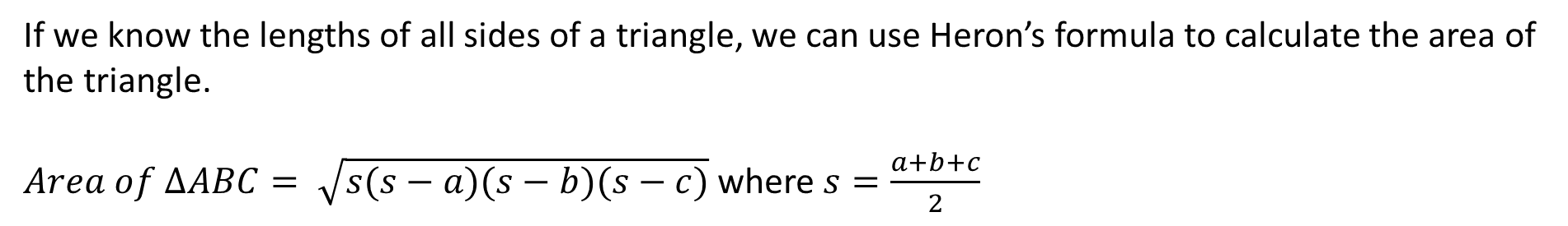



Heron’s Rule
If we know the lengths of all sides of a triangle, we can use Heron’s formula to calculate the area of the triangle.
$Area of ∆ABC= \sqrt{s(s−a)(s−b)(s−c)}$where $s=\frac{a+b+c}{2}$
$$s=\frac{8+3+9}{2}=10$$
$$Area=\sqrt{10(10−8)(10−3)(10−9)}$$
$$Area=\sqrt{10(2)(7)(1)}$$
Can also use
Class Pad
E-activity
$$Area=\sqrt{140}$$
$$Area=11.83 m^{2}$$

Slide 10
Examples
Now do exercise 11B
Given that the triangle has an area of $7 {cm}^{2}$, find $x$ correct to 1 decimal place.
$$7=\frac{1}{2}×x×4×\sin{70}$$
$$7=2×x×\sin{70}$$
$$x=\frac{7}{2×\sin{70}}$$
Can also use
Class Pad
E-activity
$$x=3.7 cm$$

